Slide 1

City of Secrets
Book Talk by Alaina Tepper

Slide 2
—Ever Barnes
“I’m here with you, Hannah. I’ll always be here with you. I won’t let you get lost like I was.”

Slide 3
01
INTRODUCTION
TO THE Book

Slide 4

City of Secrets by Victoria Ying
City of Secrets is a graphic novel that falls into the mystery genre with some elements of the steampunk subgenre. It is a Black Eyed Susan Award nominee for 2021-2022 in the Graphic Novels: Grades 6-9 category. It is written and illustrated by Victoria Ying, who has previously worked as a developmental artist on many major films.
Illustration by Victoria Ying

Slide 5
02
Setting, Characters, and Plot

Slide 6
Setting: The Grand Capital City of Oskars
All people of Oskars are connected by the Switchboard Building
The city of Oskars is a city of different levels, the farther down one goes the seedier the characters they will find. With six different levels, it’s no wonder all phone calls from the city must run through a central telephone switchboard center to get to their recipients. The switchboard building is where most of our story takes place, and is the crux of the action in this story. With levers and pulleys that change the layout of the building, one never knows what they might find...

Slide 7
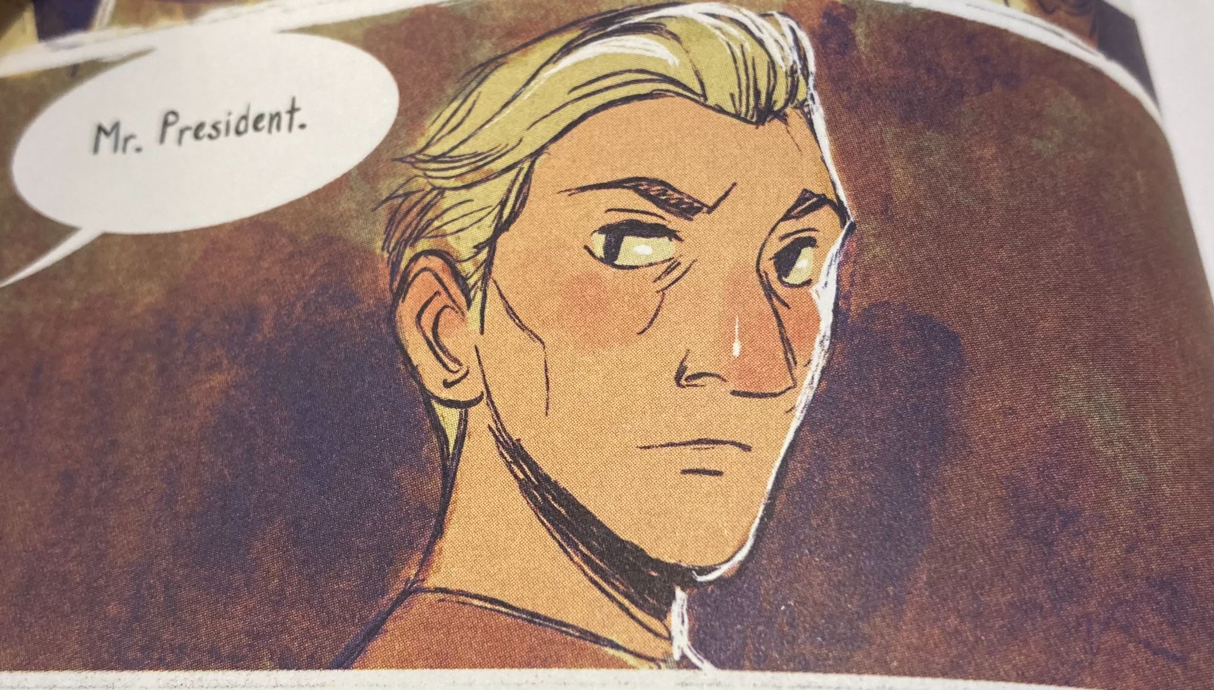
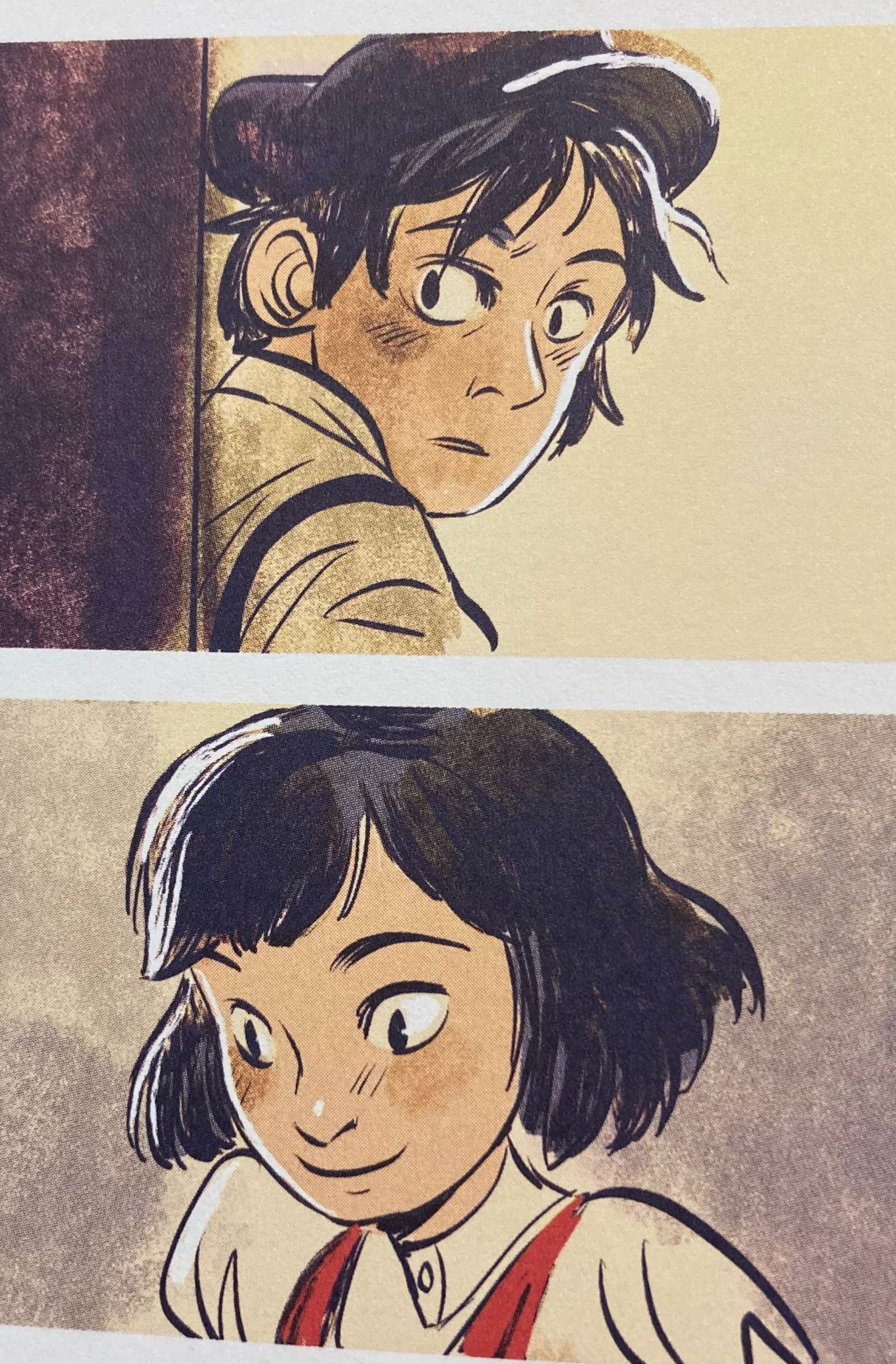
Characters: Four Families Protect the City’s Secrets
All Illustrations by Victoria Ying
Ever Barnes - an orphan boy who knows more about the switchboard building than anybody else, and he must protect its secret.
Hannah Morgan - The daughter of the switchboard building’s owner, she’s determined to make a friend of Ever.
Lisa - A worker at the switchboard building and friend of sorts to Ever, but is she more than meets the eye?
Madame Alexander - headmistress of the switchboard building, she wants Ever out of “her” switchboard building.
Vash - the new president of neighboring Edmonda, with some concerning intentions for Oskars.

Slide 8
THe Plot
Armed with the switchboard building secret, Ever and Hannah must learn to work together to discover the secrets of the four families
Madame Alexander searches out how to get rid of Ever, setting into motion Vash and the killer’s of Ever’s father to come back for Ever
02
04
01
03
05
Hannah meets Ever and is determined to help him, despite what he wants.
With the help of Lisa, Ever and Hannah dodge the killers and discover the secret of the switchboard building.
Hannah and Ever discover the power of trusting yourself and others while unlocking the many secrets of Oskars, but will it be enough before Vash can destroy them all?

Slide 9
03
Conclusion

Slide 10
Why is this book great?
The beautiful illustrations create a vivid and full world to help comprehensively develop the story
This action packed mystery graphic novel keeps the reader hanging on to every word until the resolution
Our characters learn the power of trusting your judgement and working together
Hannah is a compelling and determined female protagonist who will follow her own path to do what needs to be done

Slide 11
If you like...
Lumberjanes by Noelle Stevenson
Nancy Drew by Carolyn Keene
Etiquette and Espionage by Gail Carriger
The Magic Fish by Trung Le Nguyen
Wires and Nerve by Marissa Meyer
You’ll love the mystery and imagery of Hannah and Ever’s story in City of Secrets!

Slide 12
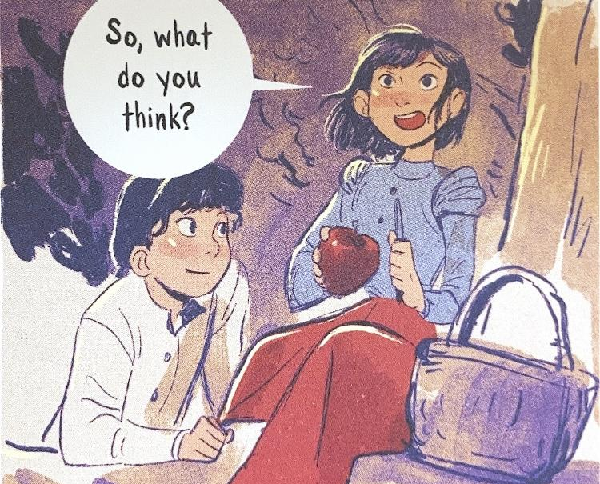
Reviews!
"A unique Ghibli-esque city that reveals some of its many mysteries through an action-packed adventure." —Molly Knox Ostertag, author-illustrator of the Witch Boy trilogy
"Victoria Ying’s lively and spirited art takes young readers by the hand and plunges them into a steampunk fantasy world." —Wendy Xu, co-creator of Mooncakes
'Ying has constructed a thrilling genre-bender . . . full-color illustrations are cinematic in scope, spotlighting the nonstop action." —Kirkus Reviews
Illustration by Victoria Ying

Slide 13
Thank you!
References:
Maryland Association of School Librarians. (2020). Current Nominees. Maryland Association of School Librarians. https://www.maslmd.org/current-nominees#gn69.
Ying, V. (n.d.). Art of Victoria Ying. http://www.victoriaying.com/.
Ying, V. (2021). City of Secrets. Amazon. https://www.amazon.com/City-Secrets-Victoria-Ying/dp/0593114493/ref=sr_1_1?crid=R8MYV9X6UXT3&amp;dchild=1&amp;keywords=city%2Bof%2Bsecrets%2Bvictoria%2Bying&amp;qid=1623720948&amp;sprefix=city%2Bof%2Bse%2Caps%2C152&amp;sr=8-1.
Please keep this slide for attribution

